Slide 1
PHOTOELECTRON SPECTROSCOPY
Using PES data and other data to understand:
Atomic structure
Electron configurations
Ionization energy
Periodic trends

Slide 2
What is PES?
Photoelectron spectrophotometers use high-energy radiation (UV or X-rays) to eject electrons from an atom
The photoelectron spectrophotometer inputs only one type of radiation (with a specific energy)
Because electrons within an atom are in different energy levels, different electrons can require different amounts of energy to eject
  Electrons that are closer to the nucleus are HARDER to remove
  (More attraction between protons and electrons)
  Valence electrons (outer level) are the EASIEST to remove
The photoelectron spectrophotometer removes electrons from multiple atoms, so electrons from all levels will be observed (& graphed)

Slide 3
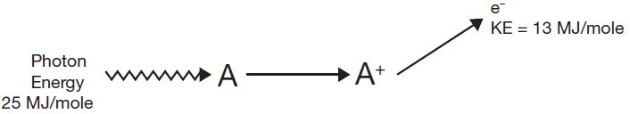
What is measured?
The “input” energy removes the electron from the atom
Any “leftover” energy determines how fast the electrons is moving when it leaves the atom
If only a small amount of energy is needed to remove an electron, a lot of energy is “leftover”
    These electrons will be moving fast
If a lot of amount of energy is needed to remove an electron, not much energy is “leftover”
    These electrons will be moving slow

Slide 4
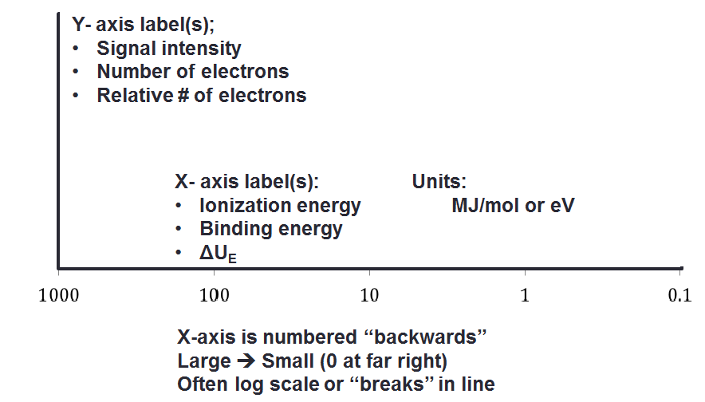
Reading PES Graphs

Slide 5
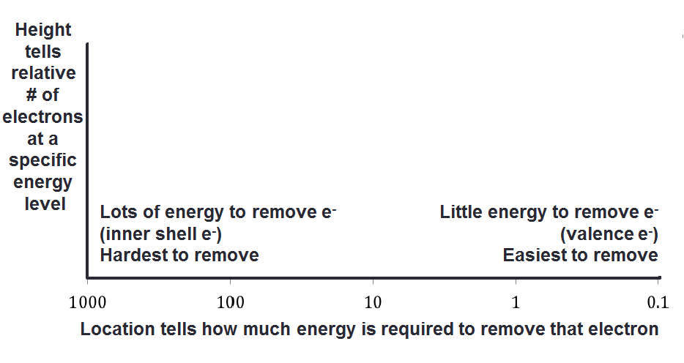
Reading PES Graphs

Slide 6
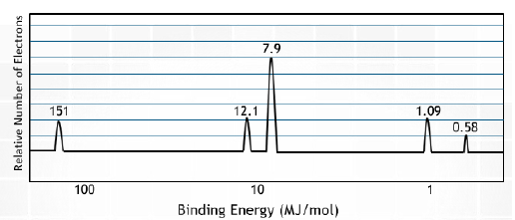
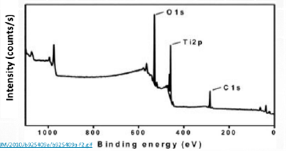
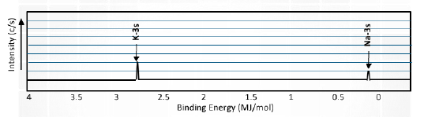
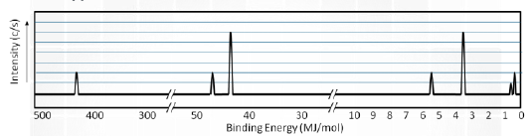
Sample Graphs

Slide 7
1

Slide 8
2

Slide 9
3

Slide 10
4

Slide 11
5

Slide 12
6

Slide 13
7

Slide 14
8

Slide 15
9

Slide 16
10

Slide 17
11

Slide 18
12

Slide 19
13

Slide 20
14

Slide 21
15

Slide 22
16

Slide 23
17

Slide 24
18

Slide 25
19

Slide 26
20

Slide 27
21

Slide 28
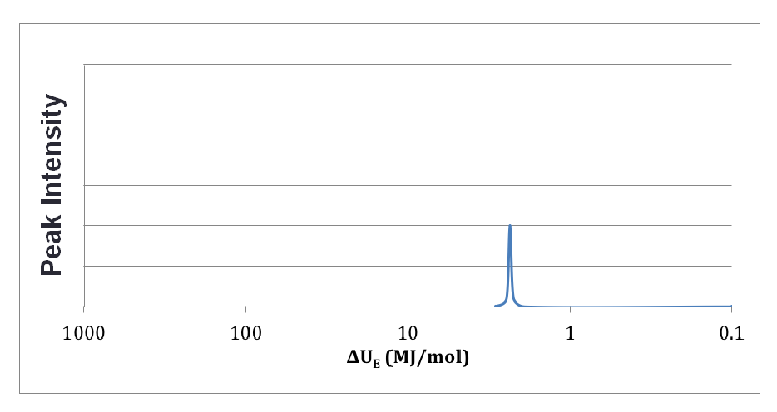
Which element?

Slide 29
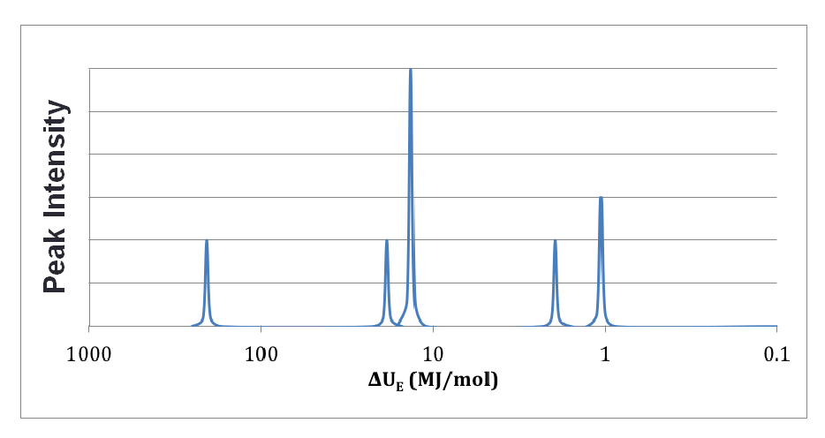
Which element?

Slide 30
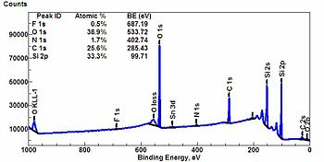
Real Spectra

